Slide 1
“Real-Time Sign Language Recognition with Audio Feedback”
Presented By-
Pradeep Maheshwari
(240340128018)
Anuj Kumar Singh
(240340128004)
Bhaaskar Krishna
(240340128006)
Ritwhick C D
(240340128023)
Sagar S Raut
(240340128027)

Slide 2
contents
INTRODUCTION
MODEL
GUI IMPLEMENTED
TEXT TRANSCRIPTION
SPEECH SYNTHESIS

Slide 3
INTRODUCTION

Slide 4
PROBLEM STATEMENT
The communication barrier between deaf or hard-of-hearing individuals and those who do not know sign language results in social isolation, limited access to education, and decreased employment opportunities for the deaf community. In order to bridge this gap and promote inclusion, there is a need for an efficient and accurate system that can recognize, transcribe, and provide real-time audio feedback for sign language communication.
Dataset Source – Kaggle
https://www.kaggle.com/datasets/grassknoted/asl-alphabet

Slide 5
methodology

Slide 6
MODEL USED - Mobilenet
MobileNet is a lightweight convolutional neural network (CNN) architecture developed by Google, designed specifically for mobile and embedded devices.
It significantly reduces computational requirements while maintaining competitive accuracy in image recognition tasks, making it ideal for real-time applications on devices with limited resources.

Slide 7
Model Customization
Base Model: The base MobileNetV2 model is loaded without the top classification layer.
Custom Layers: New layers were added on top of the base model, including:
Global Average Pooling Layer Dense Layer with 512 neurons and ReLU activation Dropout Layer with a 0.5 dropout rate to prevent overfitting Dense Output Layer with 29 neurons and softmax activation for classification

Slide 8
Layer Freezing The layers of the base MobileNetV2 model were frozen during initial training to retain the pre-trained feature extraction capabilities. Only the custom layers were trained.
Data Augmentation
Data augmentation techniques were applied to enhance the model's generalization:
Rescale: All images were rescaled by 1./255
Shear Range: Applied shearing transformations.
Zoom Range: Applied zoom-in and zoom-out transformations.
Horizontal Flip: Randomly flipped images horizontally.

Slide 9
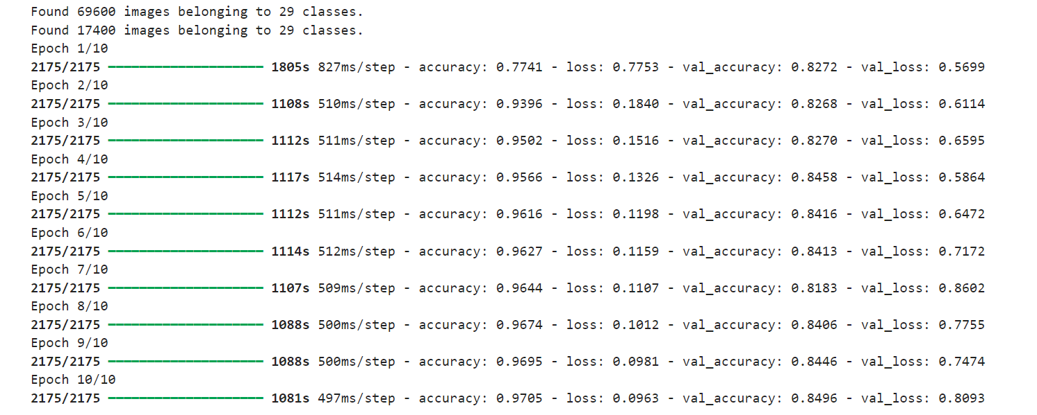
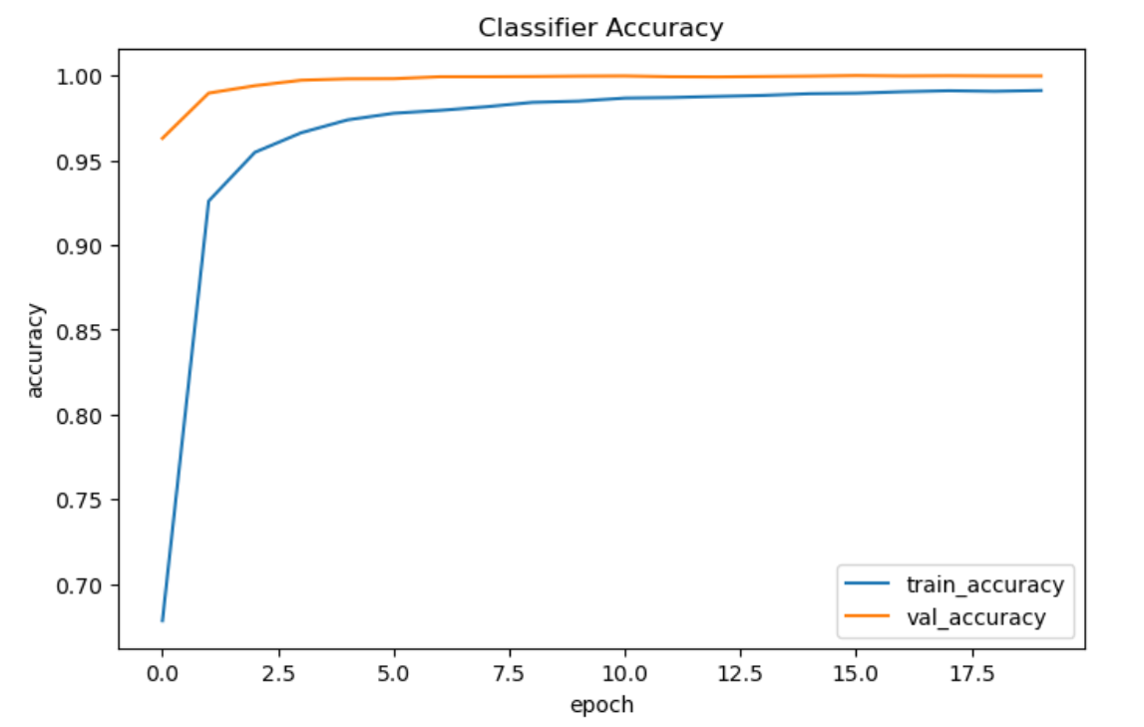

Slide 10
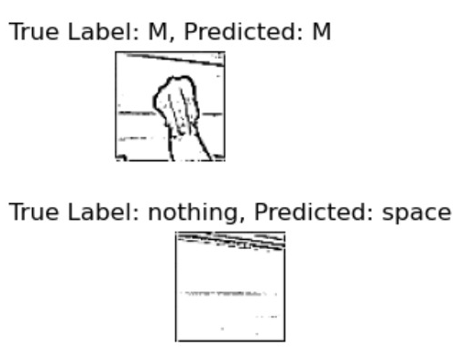
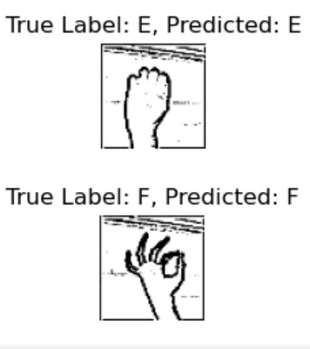
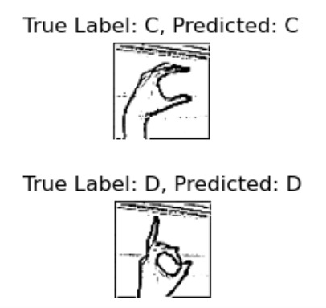
Conclusion
The fine-tuned MobileNetV2 model effectively classified ASL alphabet gestures, achieving high accuracy with minimal overfitting due to the use of dropout layers and data augmentation. The system is efficient and suitable for deployment in real-time ASL recognition applications.
Future improvements could include unfreezing additional layers of the MobileNetV2 model for further fine-tuning or incorporating more advanced augmentation techniques to improve robustness.
Accuracy was tracked across both the training and validation sets during the training process. The final accuracies were: Training Accuracy: 97.05% Validation Accuracy: 84.96%

Slide 11
MODEL USED - cnn
Convolutional Neural Networks (CNNs) are a class of deep learning models primarily used for analyzing visual imagery, designed to automatically and adaptively learn spatial hierarchies of features from input images.
CNNs excel in image and video recognition tasks due to their ability to capture local patterns and spatial relationships, leading to high accuracy in various computer vision applications.

Slide 12
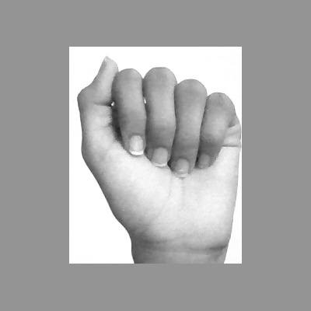
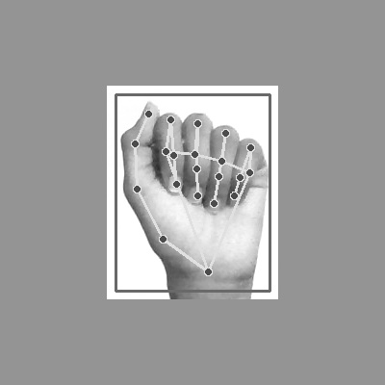

This project implements a Convolutional Neural Network (CNN) for recognizing American Sign Language (ASL) gestures using hand keypoint landmarks. The approach involves extracting keypoint data from images and feeding them into a CNN to classify ASL gestures into 29 distinct classes.

Slide 13
Model Architecture
Input Layer: Accepts input in the shape (21, 3, 1).
Convolutional Layers: Two layers with 32 and 64 filters, respectively, followed by MaxPooling layers to reduce spatial dimensions.
Flattening Layer: Converts the output into a 1D vector for fully connected layers.
Fully Connected Layers: Includes a dense layer with 128 neurons and a dropout layer to prevent overfitting.
Output Layer: Consists of 29 neurons with softmax activation for class probabilities.

Slide 14
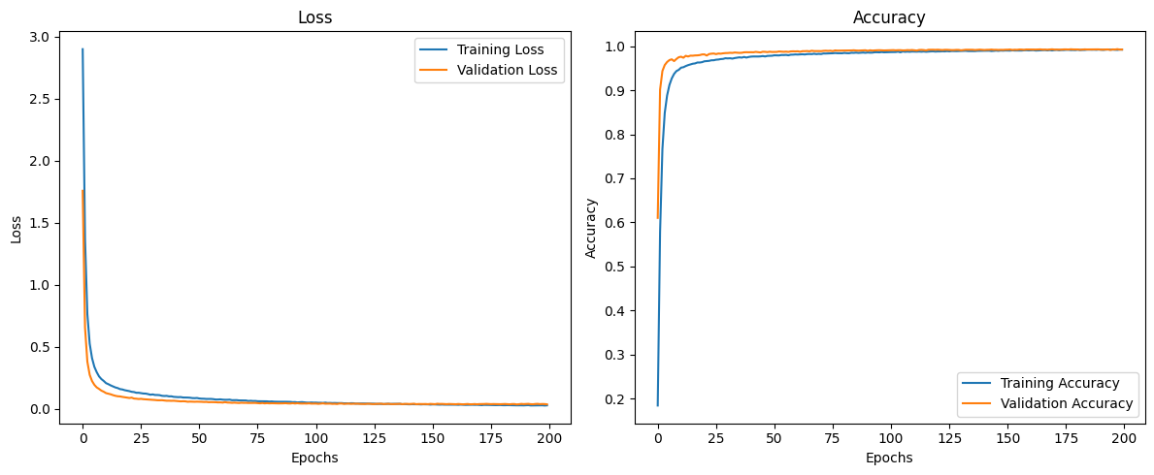
Results
Accuracy: The model achieved approximately 97% accuracy on the test set.
Confusion Matrix: Highlighted common misclassifications.
Training Curves: Illustrated the model's learning process over epochs.

Slide 15
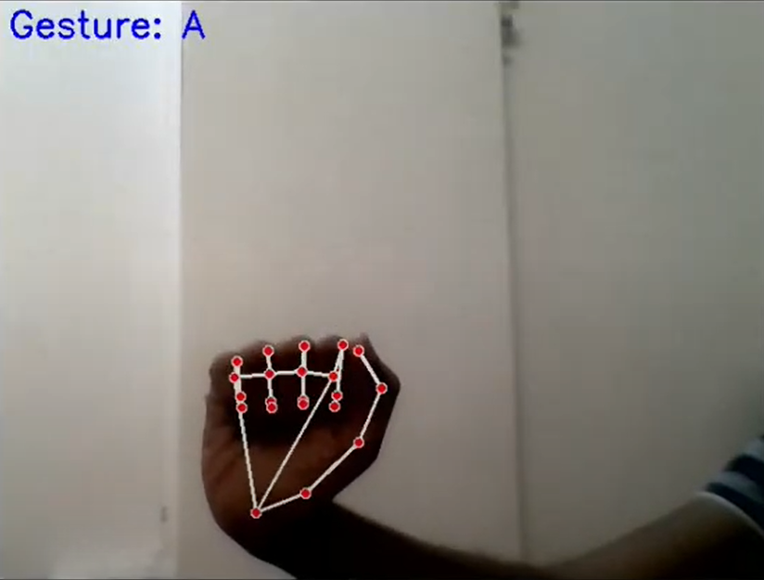
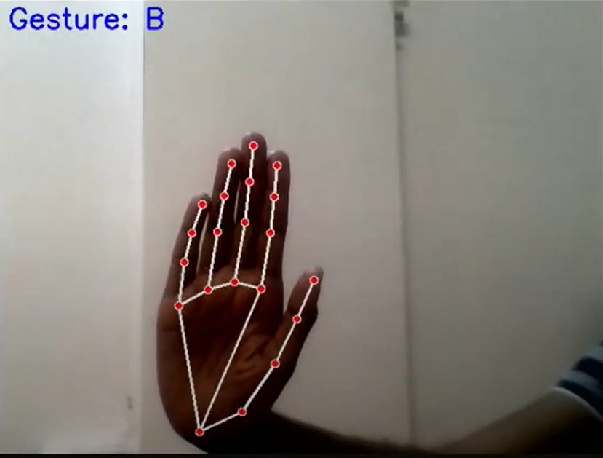
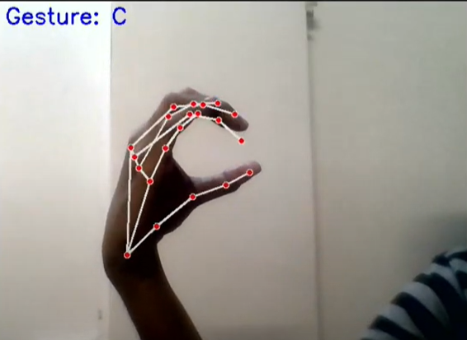
Conclusion
The CNN-based approach effectively classifies 29 ASL gestures using keypoint landmarks. Future improvements could involve refining the model architecture, exploring alternative techniques, and expanding the dataset for enhanced real-world performance.
This summary outlines the key aspects of the project, including the dataset, model architecture, training, evaluation, and real-time implementation.Bottom of Form

Slide 16
User interface

Slide 17
Objective: To create a user interface that enables effective interaction with the sign language recognition system.
TECHNOLOGIES USED:
MediaPipe Integration:
Hand Detection: MediaPipe is utilized to identify and track the user's hand in a video stream, ensuring accurate and real-time gesture recognition.
Gesture Recognition: The framework processes the detected hand region and classifies it using the fine-tuned MobileNetV2 model, aiding in the accurate recognition of sign language gestures.
Real-Time Processing:
Video Input: The system captures live video feeds from a webcam or camera, which is crucial for immediate interaction and feedback.
ROI Cropping: MediaPipe extracts the region of interest from the video frame to focus on the hand gestures, ensuring the system processes only the relevant data.
In our project, Streamlit is used to create an interactive web interface that allows users to interact with the sign language recognition system. It facilitates real-time display of recognized gestures, text output, and audio feedback, enabling seamless and intuitive user interaction with the model.
Use of Threads: Threads manage concurrent tasks, particularly for text-to-speech conversion.

Slide 18
TEXT TRANSCRIPTION

Slide 19
The text autocorrection component of this project employs NLP tools to enhance the accuracy of the text output. The process involves:
Text Simplification:
Repeated characters within words are reduced to a single occurrence to simplify the text. This is achieved using a regular expression that replaces occurrences of repeating characters (e.g., "heelllooo" becomes "helo").
Spell Correction:
The simplified text is split into individual words. Each word is processed using the TextBlob library to check and correct spelling errors. The corrected words are then reassembled into a single string.
Output:
The corrected text is returned, ensuring that spelling mistakes are minimized, and the text is more readable and accurate.
This autocorrection process leverages the capabilities of NLP libraries to provide a more refined and user-friendly text output, enhancing the overall quality of the text processing pipeline.

Slide 20
TEXT-TO-AUDIO

Slide 21
The audio generation component of this project uses the Google Text-to-Speech (gTTS) API to convert preprocessed text into speech. The process involves the following steps:
Text Preprocessing: The input text is cleaned using NLTK to remove numbers, punctuation, and stopwords, ensuring that the output speech is clear and concise.
Speech Synthesis:
The cleaned text is passed to the gTTS library, which interfaces with Google's Text-to-Speech API.
The API converts the text into a spoken format, supporting various language options and speech speeds.
Output:
The generated speech is saved as an audio file (output1.mp3).
The os module is used to play the audio file automatically on the user's system, providing immediate feedback.

Slide 22
Flow diagram

Slide 23
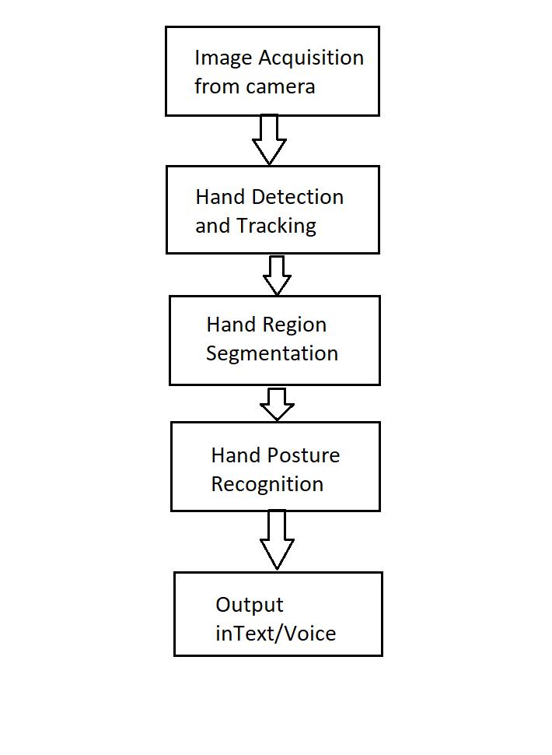
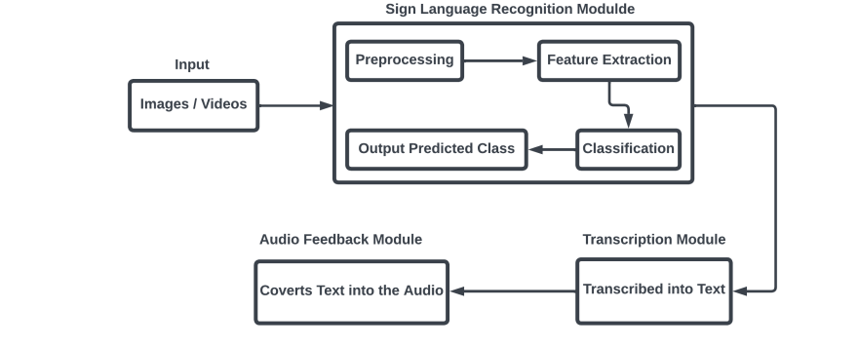

Slide 24
Results and conclusion

Slide 25

The creation of a real-time automated sign language recognition and transcription system with audio feedback marks a major milestone in assistive technology. This system’s audio feedback and instant gesture recognition and transcription could transform the way individuals with hearing impairments engage with their surroundings. It has shown promising results, with accurate recognition rates and immediate auditory feedback.

Slide 26
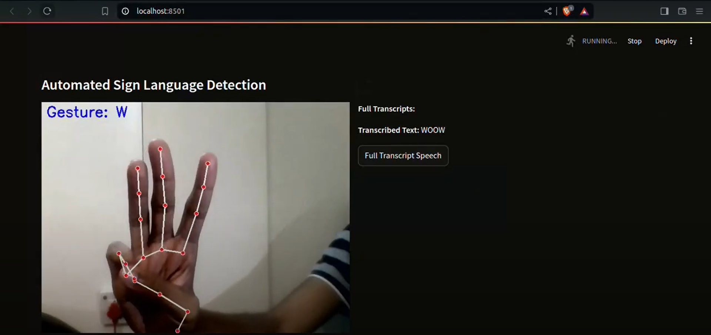
FINAL PRODUCT
Video URL: https://drive.google.com/file/d/1Hh5zt9UasZE6qjyQEYWZADRbG3ERPpJP/view?usp=sharing

Slide 27
THANK YOU !!

